Slide 1

PRACTICAL APPRACHOS FOR SOLVING LOST CIRCULATION PROBLEMS WHILE DRILLING
TEAM MEMBERS
SAKTHI DOSS .S (17612913)
RAJKUMAR .M (17612113)
UNDER THE GUIDANCE OF
MR. VIVEK TAMIZHMANI B.E,M.S,Petro
(Head Of Department Of Petroleum Engineering , VISTAS)

Slide 2
CONTENTS
INTRODUCTION
RESEARCH OBJECTIVES
RESEARCH METHODOLOGY
PURPOSE AND BENEFITS OF LOST CIRCULATION
FRACTURES IN SUBSURFACE
FUNDAMENTALS OF LOST CIRCULATION CONTROL
TYPES OF LOSSES IN THE LOST CIRCULATION
LOST CIRCULATION MATERIALS SELECTION (LCMs)

Slide 3
INTRODUCTION
What is lost circulation?
Types of lost circulation

Slide 4
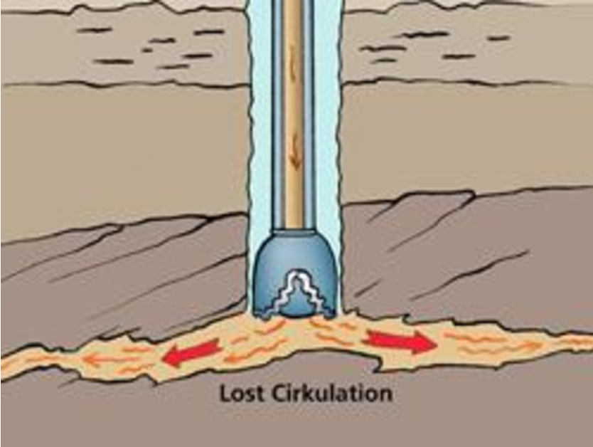
INTRODUCTION
LOST CIRCULATION:
Loss of drilling fluid into the formation during drilling,
Circulating or running casing.
One of the major problems in drilling operation.
Such problems in drilling are not confined to any area;
they may occurs any depth.
The zone where the mud is lost is called thief zone or lost
Circulation zone.
Lost circulation inside a formation

Slide 5
RESEARCH OBJECTIVES
The objectives of this study are as follows:
To review lost circulation control methods that have been applied in the drilling industry till date.
To provide the successes and the failures of the methods presented above in field applications.
To develop practical guidelines that will serve as a reference material for lost circulation control at the well-site for drilling personnel.

Slide 6
RESEARCH METHODOLOGY
The objectives of this study will be achieved through the following methods:
Read various technical journals, papers and textbooks that talk on the subject of lost circulation control over the years in the drilling industry.
Summarize these technical materials based on the various lost circulation control methods used over time, their success stories, and their failures in various field applications.
Develop practical guidelines based on the above methods.

Slide 7
LOST CIRCULATION
Purpose of lost circulation
Benefits of lost circulation

Slide 8
FRACTURES IN SUBSURFACES
In fractured rocks, groundwater flow occurs predominantly through the connected network of discrete fractures. A series of geophysical investigations has confirmed that subsurface fracture networks can commonly be described by fractal geometry.
Types of fractures
Natural fracture
Induced fracture

Slide 9
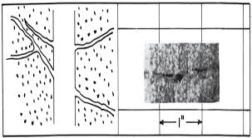
Causes of Lost circulation
Natural fractures causes :
natural fractures in formations, and cavernous
formations.
Through the openings in the rock in low pressure or
Depleted zones.
Natural or intrinsic fractures
source: Howard and Scott.

Slide 10
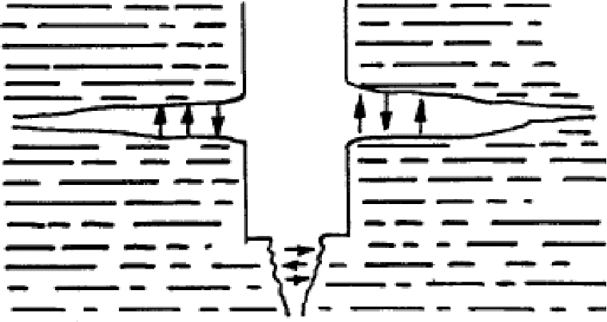
Causes of Lost circulation
Induced fractures causes:
mainly by poor drilling practices:
occurs when hydrastatic pressure of mud exceeds
the breaking strength of the formation
.
surging .
Induced fractures
Source: Howard and Scott.

Slide 11
FUNDAMENTALS OF LOST CIRCULATION CONTROL
A lot of effort has been done to understand the mechanics of lost circulation control. Lost circulation control during well construction is more than just selecting the right lost circulation material (LCM) but requires a complete engineered approac.
borehole stability analysis,
equivalent circulating density (ECD) modelling,
leak-off flow-path geometry considerations,
drilling fluid and LCM selection to help minimize effects on ECD,
on-site monitoring using annular pressure while drilling (APWD)

Slide 12
TYPES OF LOSSES IN THE LOST CIRCULATION

Slide 13
Lost circulation
Indication of lost circulation
How to prevent lost circulation ?
Flow out less then flow in.
Lack of flow
Increase string weight
Increase pump speed
causes loss of bottom hole pressure
Increase chance of taking a kich
Using proper mud weight
Conduct tests such as leak of test and formation integrity test.
Maintain good hole cleaning
Setting casing to protect upper weaker formations.

Slide 14
LOST CIRCULATION MATERIALS (LCMs) SELECTION
Conventional lost circulation material
Fibers, flakes,
And granules
High fluid loss squeezes
Diatomaceous earth or clay blend
Gunk slurries
Diesel oil bentonite
Source: Lost circulation material selection in drilling operation

Slide 15
Diaseal M LCM Using For Lost Circulation Problem
R
Description:
• A filtration activated pill material
• High fluid loss, high solids, lost circulation squeeze product. Can be enhanced with cement for greater compressive strength
Formations:
• Fractured or highly permeable formations
Mud Types:
• All water and oil based muds
Applications:
• Partial lost returns while drilling
• Total lost returns while drilling
• Squeeze off casing leaks or perforations for well remediation

Slide 16
DIASEAL M® LOST CIRCULATION MATERIAL CASE HISTORIE
CASE HISTORY – LOUISIANA, USA
An operator in Perry, Louisiana had drilled out of 7 5/8” casing with an 18.1 ppg mud.
After 1,200 feet had been drilled, drilling fluid losses of 71.2 bbl/hour were noted. For the 70 bbl of open hole volume, a 150 bbl Diaseal M® LCM pill was squeezed to a 250 psi holding pressure.
The procedure was successful and the well was TD’d at 14, 500 feet without further problems.

Slide 17
THANK YOU …

